Slide 1
Career Presentation
Sound Technician
By Victor Robles

Slide 2
Sound Technician
-A Sound Technician is responsible for making sure that all equipment is working properly and the sound is mixed well during live events
- They can also work in studios working on scores for movies, sound mixing for music and audio for Television and commercials .
-Technicians may also have to work with visual effects during live events.
-Set up and put away sound equipment after a show.

Slide 3
Education or Training Requirements
-An associate degree in production and audio engineering.
-Can be acquired through college programs or through a trade school.
-Tuition cost is $22,000-$25,000 through trade school. $88,000-$122,00 through a 4-year college
-Taking up an apprenticeship with experienced technicians is strongly recommended

Slide 4
Who’s Hiring?
-Music Venues, Studios ,Live events,nightclubs, industry and just about anywhere where sound quality is needed.
-Popular jobs in big cities like Los Angeles, New York, Chicago etc...
-Annual salary can range from $60,000-$120,000

Slide 5
Career Prospects
-There are currently around 13,000 to 15,000 jobs availabe for sound technicians today
- Sound Technician jobs are expected to rise up 9% in the next decade
-With the rise of technology , its difficult to find obsolescence for these kinds of jobs.

Slide 6
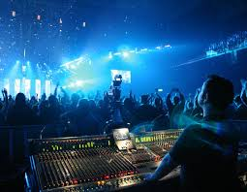
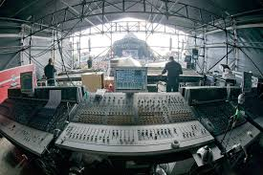
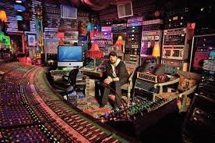
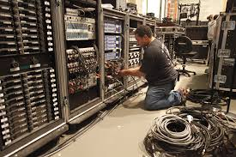
What it looks like.

