Slide 1
Career Presentation:
Political Science
Irving Mendoza
Notes:
My presentation might seem lacking but I will discuss the topics when I present.

Slide 2
Political Science
Read the news
Fix economic problems
Discuss issues
Teach class(professor)
Practice law

Slide 3
Education or Training Requirements
Degree in political science, public administration, or a related field.
Top schools are: UCB, UCSD, UCI, UCSB, UCLA, USC
Around $37,000 to $48,000
Master’s Degree or PhD. (6-8 years)
Internship for experience

Slide 4
Who’s Hiring?
Jobs in federal, state, and local government
Salary range: $38,000-$104,00
Benefits vary from each profession

Slide 5
What are the Career Prospects?
What does employment look like today?
Future is great- variety of jobs
Employment trends will impact the field by having more people in seven years join the political science field which will flood the market

Slide 6
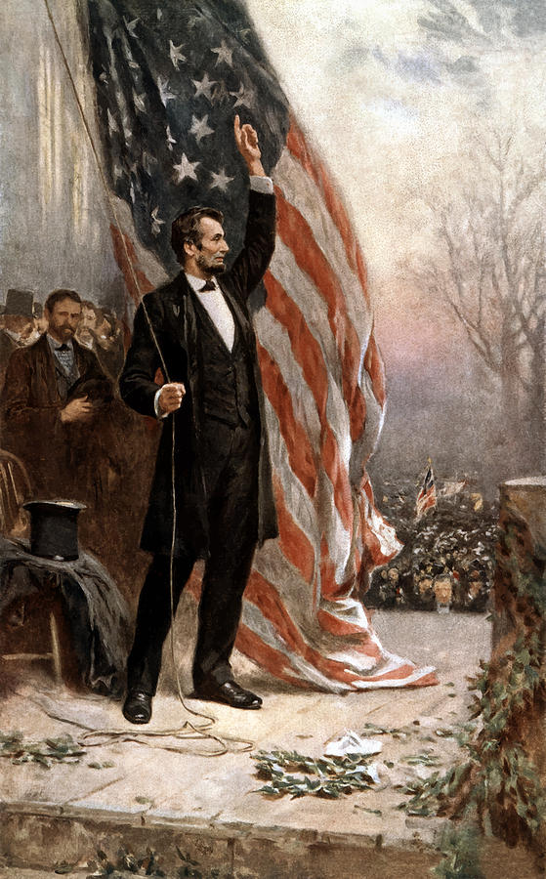
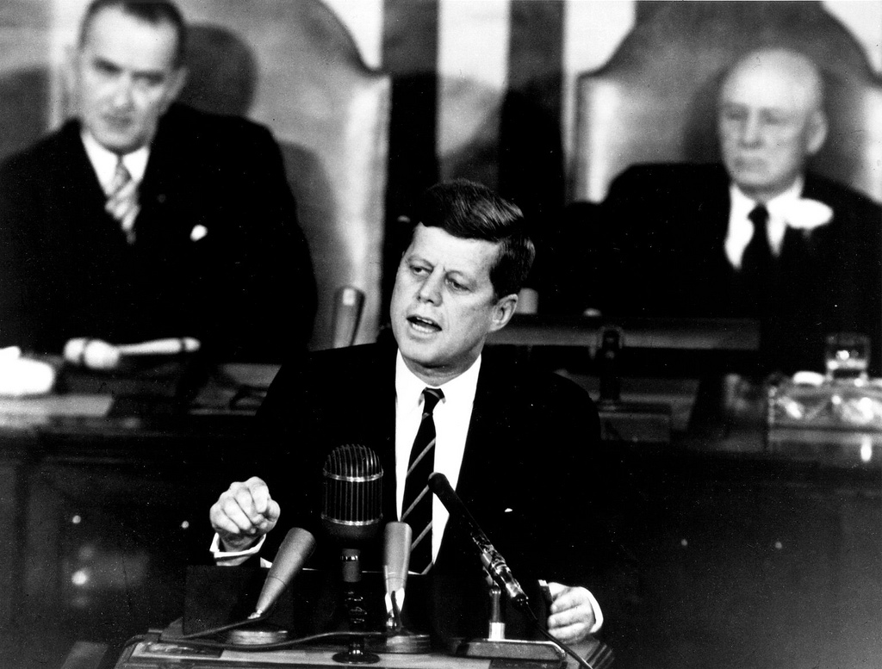
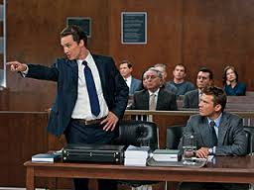
What does it look like?
People who do the job – Politicians, Lawyers, Business Managers,
Pictures on the job --

